Slide 1
Event-Driven Programming techniques AWT SWING

Slide 2
Java GUI History
Abstract Windowing Toolkit (AWT): Sun's initial effort to create a set of cross-platform GUI classes. (JDK 1.0 - 1.1)
Maps general Java code to each operating system's real GUI system.
Problems: Limited to lowest common denominator; clunky to use.

Slide 3
GUI terminology
window: A first-class citizen of the graphical desktop.
Also called a top-level container.
examples: frame, dialog box, applet
component: A GUI widget that resides in a window.
Also called controls in many other languages.
examples: button, text box, label
container: A logical grouping for storing components.
examples: panel, box

Slide 4
Working with 2D Shapes
Using Colors

Slide 5
Drawing a Line
void drawLine(int startX, int startY, int endX, int endY)
It draws a line in the current drawing color that begins at startX, startY and ends at endX, endY.

Slide 6
// Draw lines
import java.awt.*;
import java.applet.*;
/* <applet code="Lines" width=300 height=200>
</applet> */
public class Lines extends Applet {
public void paint(Graphics g) {
g.setColor(Color.red);
g.drawLine(0, 0, 100, 100);
g.setColor(Color.black);
g.drawLine(0, 100, 100, 0);
g.setColor(Color.magenta);
g.drawLine(40, 25, 250, 180);
}
}

Slide 7
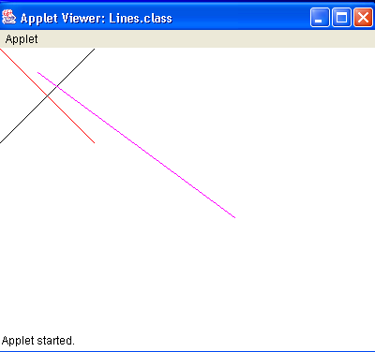

Slide 8
Working with 2D Shapes
Rectangle

Slide 9
Drawing a Rectangle
void drawRect(int top, int left, int width, int height)
void fillRect(int top, int left, int width, int height)
The upper-left corner of the rectangle is at top, left. The dimensions of the Rectangle are specified by width and height.

Slide 10
void drawRoundRect(int top, int left, int width, int height, int xDiam, int yDiam)
void fillRoundRect(int top, int left, int width, int height, int xDiam, int yDiam)
A rounded rectangle has rounded corners.
The diameter of the rounding arc along X axis is specified by xDiam.
The diameter of the rounding arc along Y axis is yDiam.

Slide 11
// Draw rectangles
import java.awt.*;
import java.applet.*;
/*
<applet code="Rectangles" width=300 height=200>
</applet>
*/
public class Rectangles extends Applet {
public void paint(Graphics g) {
g.drawRect(10, 10, 60, 50);
g.fillRect(100, 10, 60, 50);
g.setColor(Color.red);
g.drawRoundRect(190, 10, 60, 50, 20, 30);
g.fillRoundRect(270, 10, 60, 50, 20, 30);

Slide 12
g.setColor(Color.red);
g.drawRect(10, 90, 140, 140);
g.setColor(Color.blue);
g.drawRoundRect(10, 90, 140, 140, 200, 40);
g.setColor(Color.red);
g.drawRect(200, 90, 140, 140);
g.setColor(Color.blue);
g.drawRoundRect(200, 90, 140, 140, 40, 200);
}
}

Slide 13
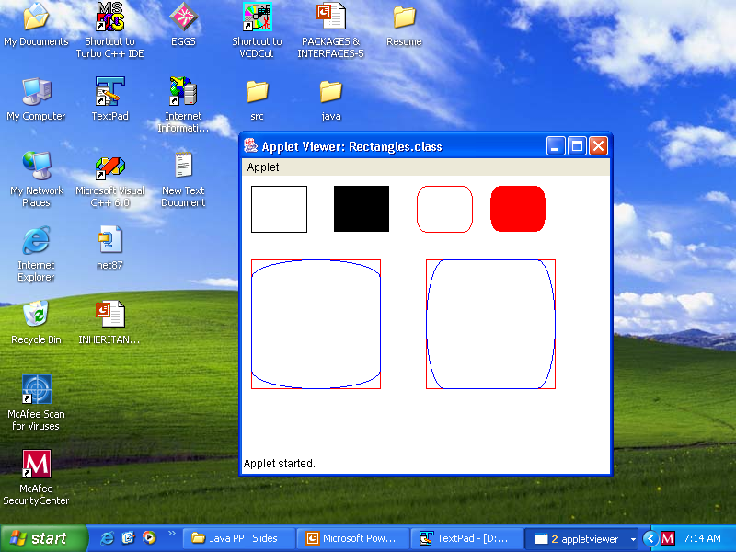

Slide 14
Following values can be assigned to name in Color.name
black, blue, cyan, darkGray, gray, green, lightGray, magenta, orange, pink, red, white, yellow

Slide 15
Drawing Ellipses and Circles
void drawOval(int top, int left, int width, int height)
void fillOval(int top, int left, int width, int height)
The ellipse is drawn within a bounding rectangle whose upper-left corner is at top, left and whose dimensions are specified by width and height.
If the height and width are same, it becomes a circle.

Slide 16
// Draw Ellipses
import java.awt.*;
import java.applet.*;
/*
<applet code="Ellipses" width=300 height=200>
</applet>
*/
public class Ellipses extends Applet {
public void paint(Graphics g) {
g.setColor(Color.red);
g.drawRect(10, 10, 50, 50);
g.drawOval(10, 10, 50, 50);
g.drawRect(100, 10, 75, 50);
g.fillOval(100, 10, 75, 50);

Slide 17
g.setColor(Color.cyan);
g.drawRect(190, 10, 90, 30);
g.drawOval(190, 10, 90, 30);
g.setColor(Color.magenta);
g.drawRect(70, 90, 100, 100);
g.fillOval(70, 90, 100, 100);
}
}

Slide 18
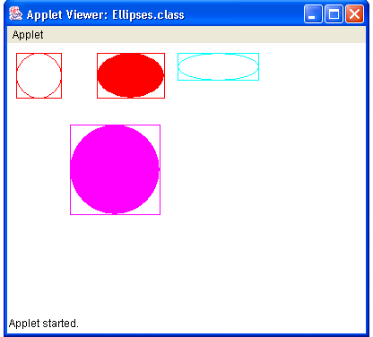

Slide 19
Drawing Arcs
void drawArc(int top, int left, int width , int height, int startAngle, int sweepAngle)
void fillArc(int top, int left, int width , int height, int startAngle, int sweepAngle)
The arc is bounded by a rectangle whose upper-left corner is at top, left and whose dimensions are specified by width and height.

Slide 20
The arc is drawn from startAngle through the angular distance specified by sweepAngle.
Angles are specified in degrees.
Zero degrees is on the horizontal, at 3 O’ clock position.
The arc is drawn anticlockwise if sweepAngle is positive and clockwise if it is negative.
Therefore, to draw an arc from 12 o’clock to 6 o’clock, the startAngle would be 90 and the sweepAngle is 180.

Slide 21
12 O’clock
90 degrees
9 O’ clock
180 degrees
3 O’ clock
0 degrees
6 O’ clock
270 degrees

Slide 22
// Draw Arcs
import java.awt.*;
import java.applet.*;
/* <applet code="Arcs" width=300 height=200>
</applet> */
public class Arcs extends Applet {
public void paint(Graphics g) {
g.setColor(Color.red);
g.drawRect(10, 40, 70, 70);
g.drawArc(10, 40, 70, 70, 0, 75);
g.setColor(Color.red);
g.drawRect(100, 40, 70, 70);
g.fillArc(100, 40, 70, 70, 0, 75);

Slide 23
g.setColor(Color.blue);
g.drawRect(10, 120, 70, 80);
g.drawArc(10, 120, 70, 80, 0, 175);
g.setColor(Color.blue);
g.drawRect(100, 120, 70, 90);
g.fillArc(100, 120, 70, 90, 0, 270);
g.setColor(Color.black);
g.drawRect(200, 80, 80, 80);
g.drawArc(200, 80, 80, 80, 0, 180);
g.setColor(Color.black);
g.drawRect(300, 80, 80, 80);
g.fillArc(300, 80, 80, 80, 0, -180);
}
}

Slide 24
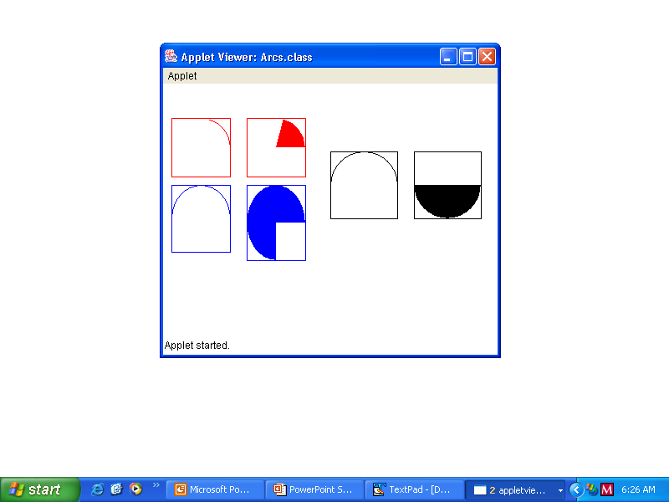

Slide 25
Drawing Polygons
A polygon is a closed sequence of line segments.
Given a sequence of points (called vertices), line segments connect one vertex to the next in the sequence, finishing with the last vertex being connected with the first one.

Slide 26
void drawPolygon(int x[], int y[], int numPoints)
void fillPolygon(int x[], int y[], int numPoints)
x[] is an array of integers containing x coordinates
y[] is an array of integers containing y coordinates
numPoints is the total number of points and is equal to x.length or y.length

Slide 27
// Draw Polygon
import java.awt.*;
import java.applet.*;
/*
<applet code="HourGlass" width=230 height=210>
</applet>
*/
public class HourGlass extends Applet {
public void paint(Graphics g) {
int xpoints[] = {30, 200, 30, 200, 30};
int ypoints[] = {30, 30, 200, 200, 30};
int num = 5;
g.drawPolygon(xpoints, ypoints, num);
}
}

Slide 28
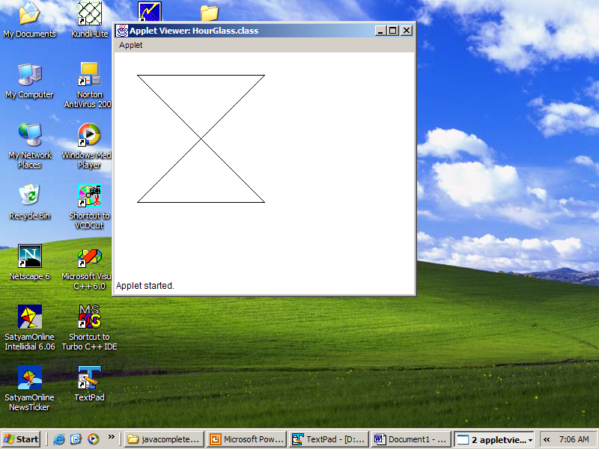

Slide 29
// Draw Polygon
import java.awt.*;
import java.applet.*;
/*
<applet code="HourGlass" width=230 height=210>
</applet>
*/
public class HourGlass extends Applet {
public void paint(Graphics g) {
Polygon poly = new Polygon();
poly.addPoint(30,30);
poly.addPoint(200,30);
poly.addPoint(30,200);
poly.addPoint(200,200);
poly.addPoint(30,30);
g.drawPolygon(poly);
}
}

Slide 30
Working with 2D Shapes
Using Fonts

Slide 31
Working with Fonts
To select a new font, you must first construct a Font object that describes that font. The Font constructor is:
Font(String fontName, int fontStyle, int pointSize)
fontName specifies the name of the desired font.
fontStyle may contain these values:
Font.PLAIN(0), Font.BOLD(1), Font.ITALIC(2)
We can combine two styles as
Font. PLAIN | Font.ITALIC (0+2=2),
Font.BOLD | Font.ITALIC (1+2=3)
pointSize specifies the font size

Slide 32
To use a font that you have created, you must select it using setFont() which is defined by the Component class
its general form is :
void setFont(Font fontObj)
Dialog is the default font if you don’t explicitly set a font

Slide 33
// Show fonts.
import java.applet.*;
import java.awt.*;
import java.awt.event.*;
/* <applet code="SampleFonts" width=200 height=100>
</applet>*/
public class SampleFonts extends Applet {
Font f; String msg;
public void init( ) {
f = new Font("Times New Roman", Font.BOLD, 18);
msg = "This font is \"Times New Roman\"";
setFont(f);
}
public void paint(Graphics g) {
g.setColor(Color.red);
g.drawString(msg, 4, 40);
}
}

Slide 34
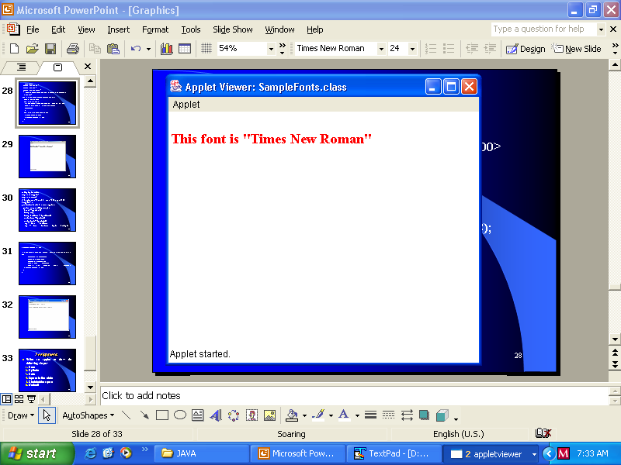

Slide 35
// Display font info.
import java.applet.*;
import java.awt.*;
/*<applet code="FontInfo" width=350 height=60>
</applet> */
public class FontInfo extends Applet {
public void paint(Graphics g) {
Font f = g.getFont();
String msg;
String fontName = f.getName();
int fontSize = f.getSize();
int fontStyle = f.getStyle();
msg = "Font: " + fontName;
msg += ", Size: " + fontSize + ", Style: " +fontStyle;

Slide 36
g.drawString(msg, 5, 15);
f = new Font("Times New Roman", Font.ITALIC | Font.BOLD, 18);
fontName = f.getName();
fontSize = f.getSize();
fontStyle = f.getStyle();
msg = "Font: " + fontName;
msg += ", Size: " + fontSize + ", Style: " +fontStyle;
g.drawString(msg, 5, 50);
}
}

Slide 37
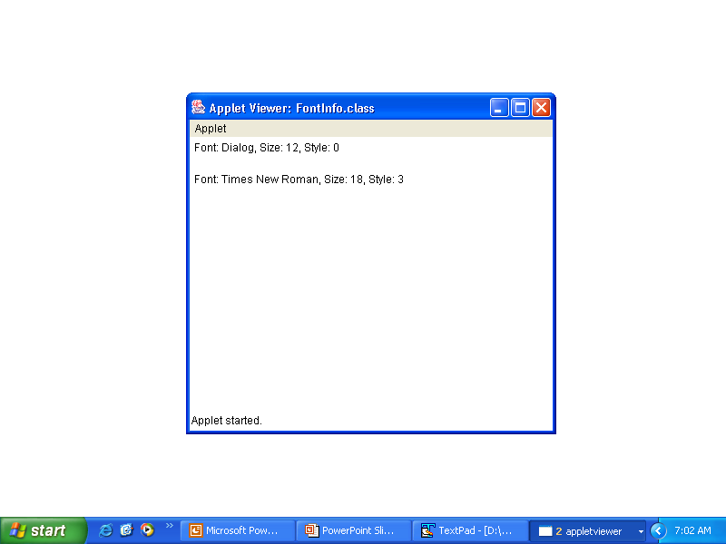

Slide 38
Working with 2D Shapes
Using Images

Slide 39
//Drawing Images
import java.applet.Applet;
import java.awt.Graphics;
import java.awt.*;
import java.net.*;
public class SimpleImageApplet extends Applet
{
Image img; URL url; int w,h;
public void init()
{
setBackground(Color.blue);
setForeground(Color.white);
url= getCodeBase();
img= getImage(url,"bear.jpg");

Slide 40
w= getWidth();
h= getHeight();
}
public void paint(Graphics g)
{
showStatus("Width="+w+" Height="+h);
g.drawString("Image in Applet",10,15);
g.drawImage(img,30,70,w,h,this);
}
}

Slide 41
Save the file SimpleImageApplet.java file in C:\Applet\Java
And save the file SimpleImageApplet.class file in C:\Applet\class
Save the image bear.jpg in C:\Applet\class

Slide 42
//Write the following code in SimpleImageApplet.html and save it in C:\Applet\html
<html>
<applet code = SimpleImageApplet codebase="../class" width=150 height=150> Sorry, your browser is not java enabled</applet>
</html>

Slide 43
